Slide 1
Matrix Algebra
2.5 Matrix Factorization
Bumhee Cho

Slide 2
Factorization
a product of two or more matrices
A = BC

Slide 3
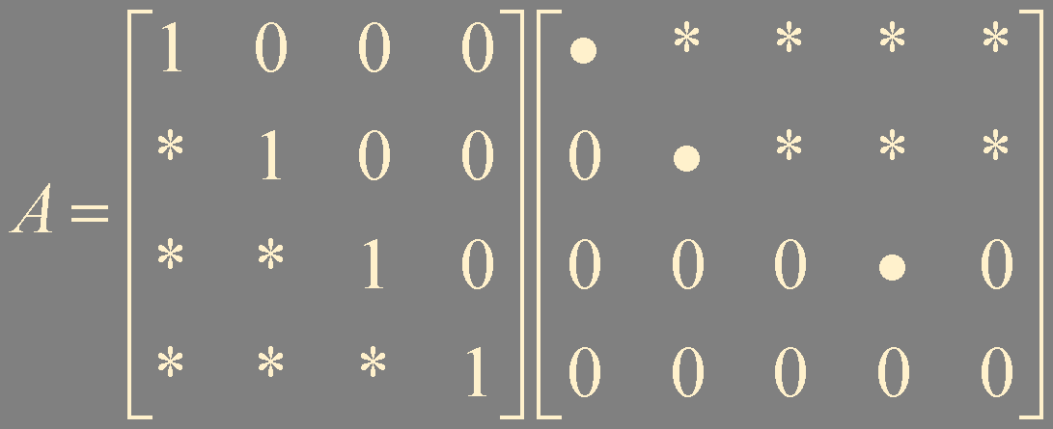
LU Factorization
L
U
a unit lower triangular matrix
echelon form
without row interchanges
without scalings

Slide 4
Useful?
A = LU
Ax = b
LUx = b
Ux = y
Ly = b
Ux = y

Slide 5

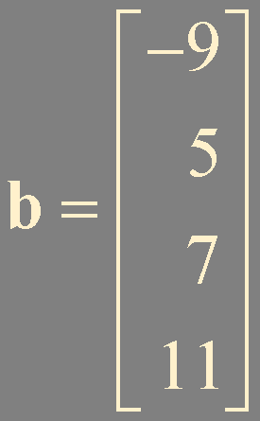
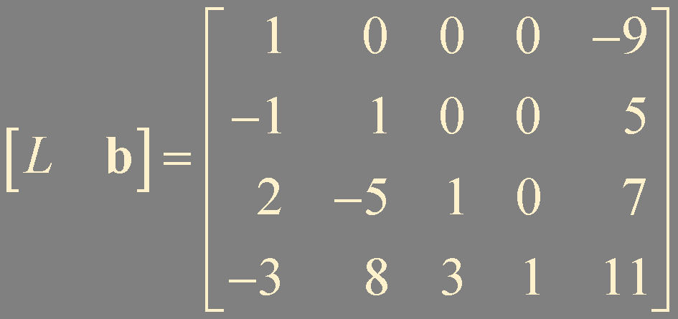
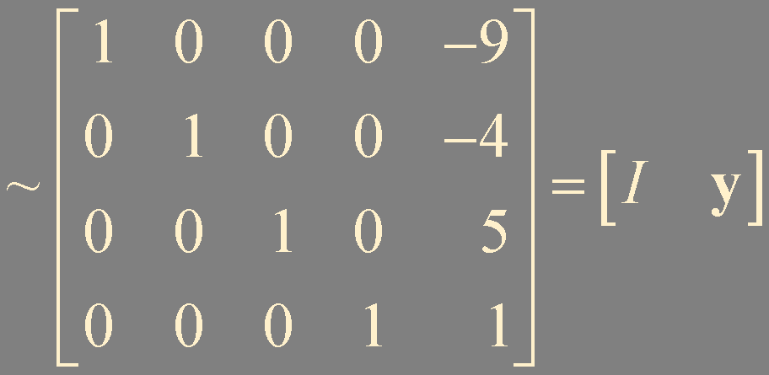
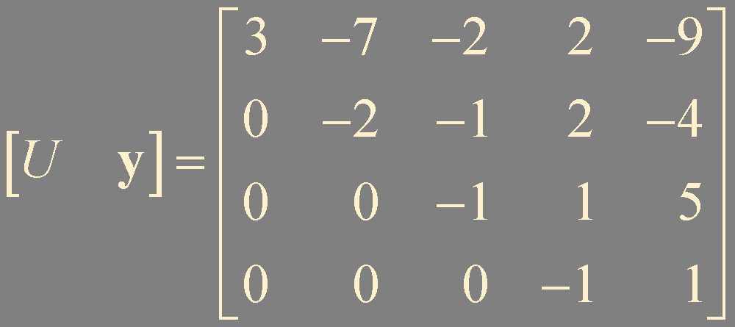
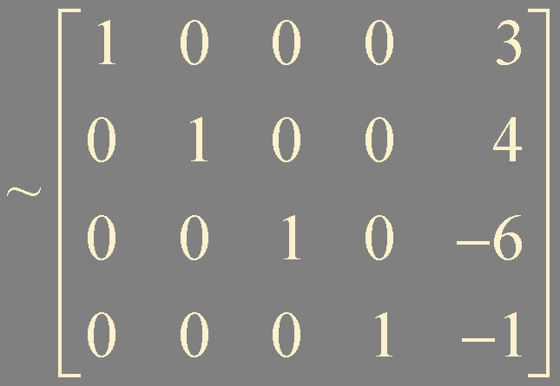
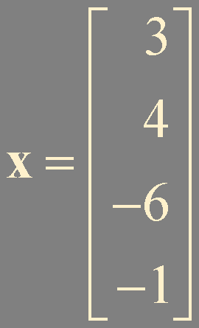
Example 1.
L
U

Slide 6
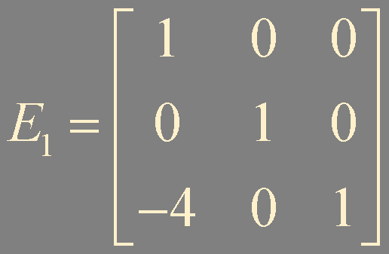



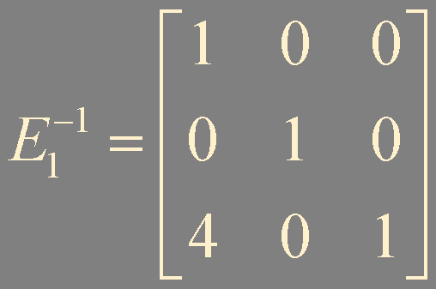





LU Factorization Algorithm
* only by row replacements
unit lower triangular elementary matrices
unit lower triangular
Reduce A to an echelon form U by a sequence of row replacement operations, if possible
Place entries in L such that the same sequence of row operations reduced L to I

Slide 7
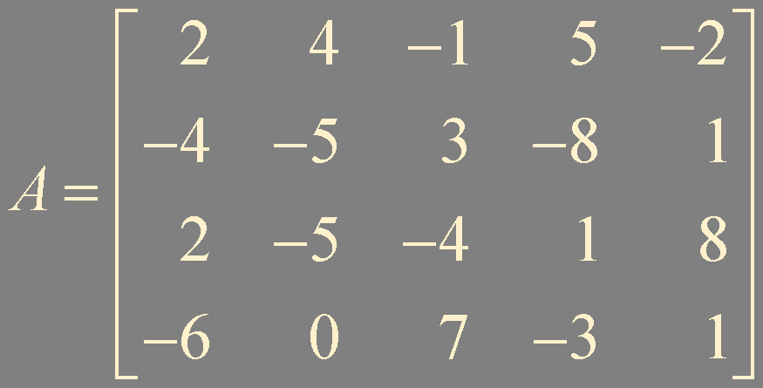
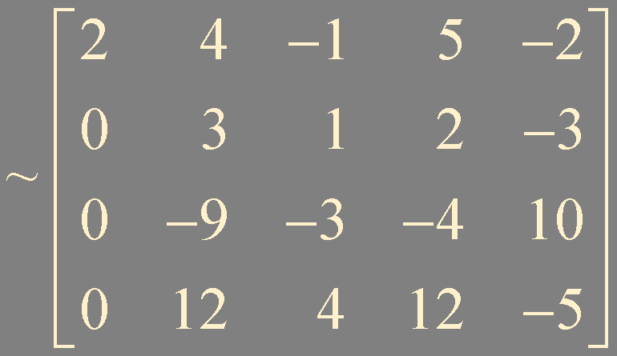
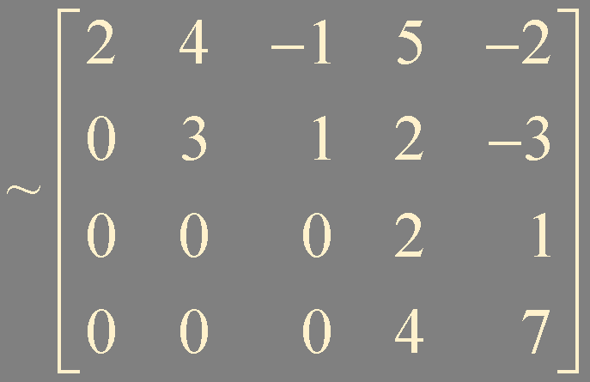
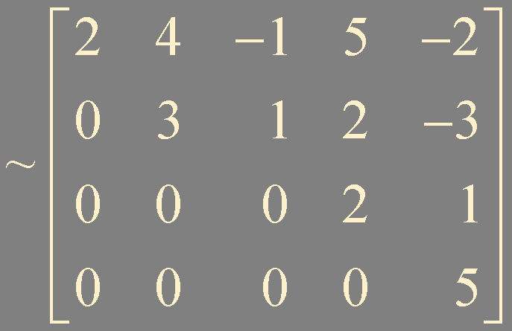


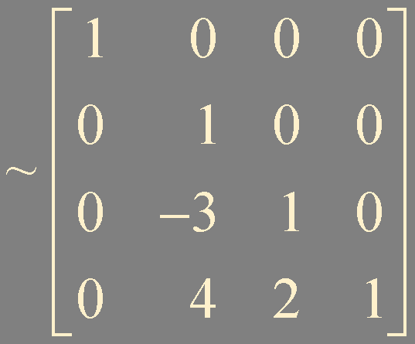
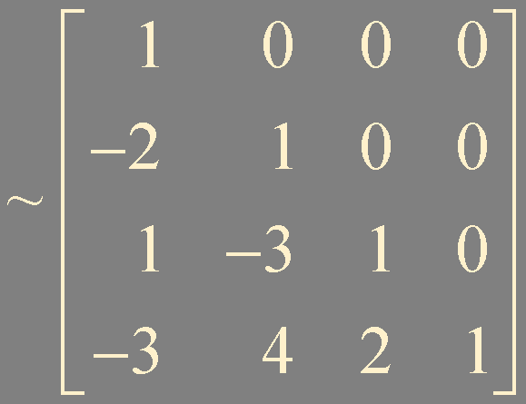



Example 2.
U
[5]
L

Slide 8
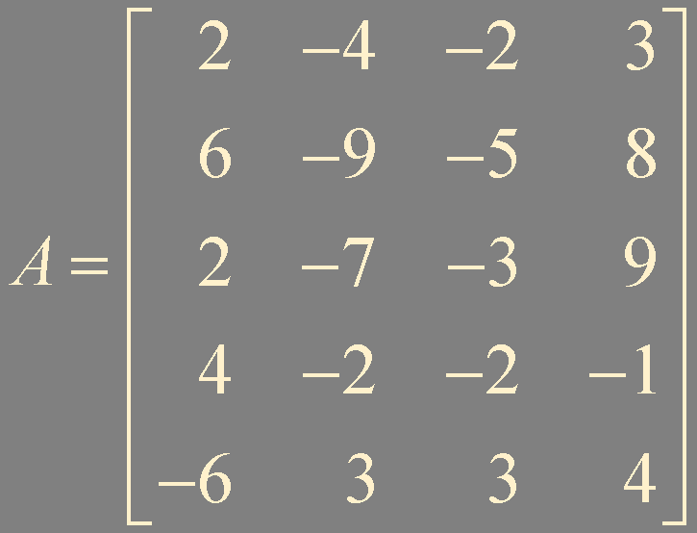
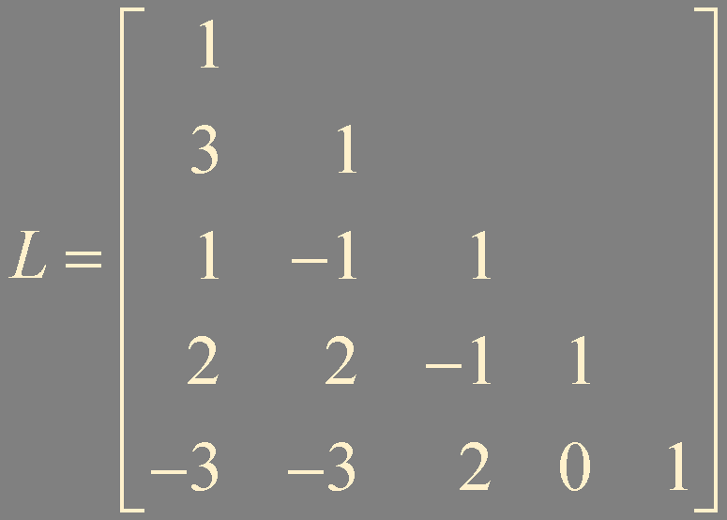
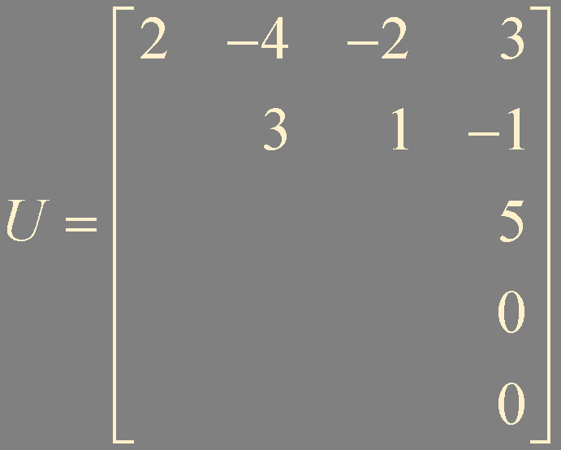
Example 3.

Slide 9
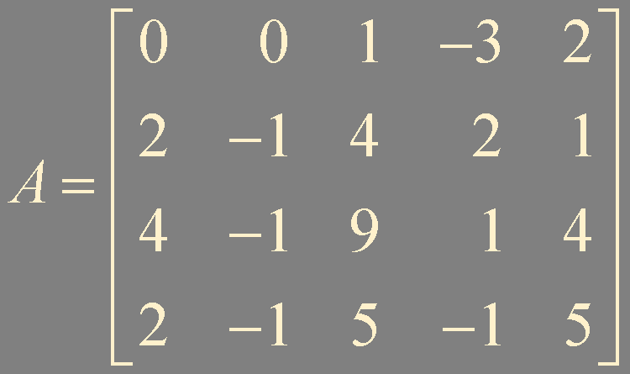
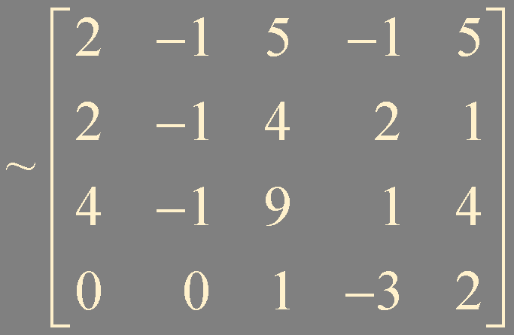
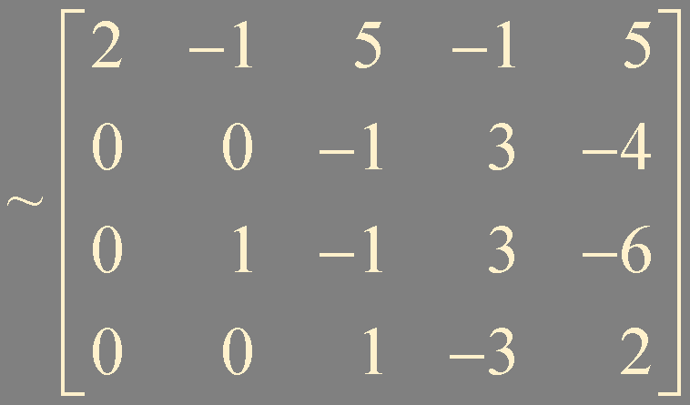
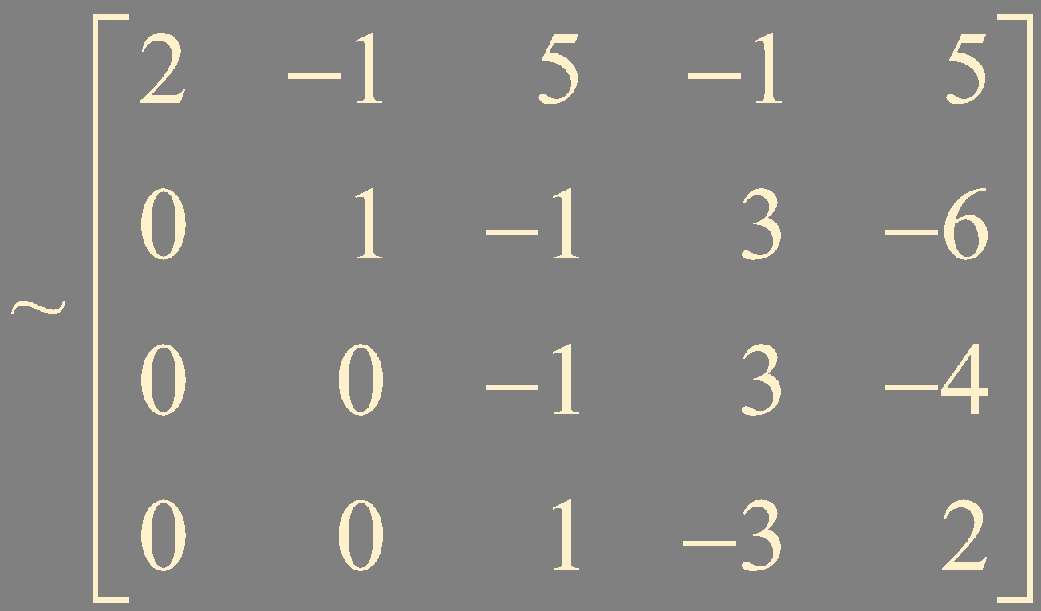
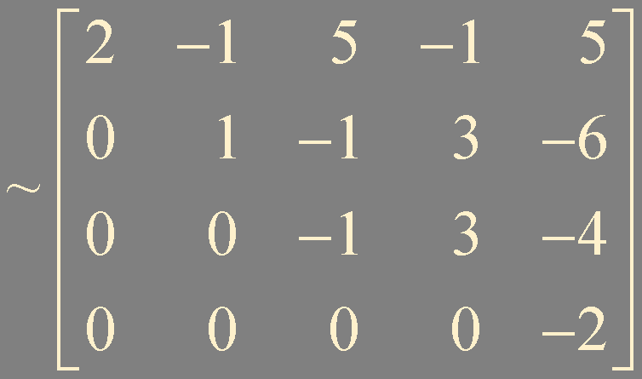
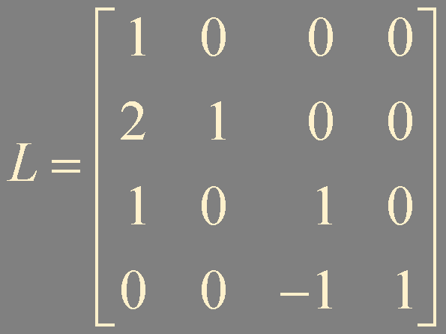
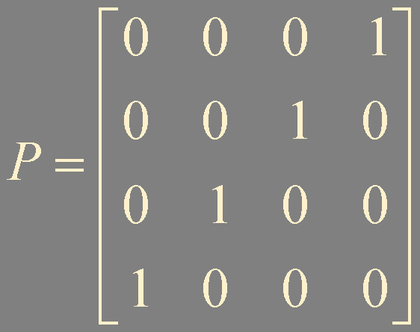
General Case
PA = LU
U

Slide 10
Numerical Notes
LU ~ 2n³/3 flops
A⁻¹ ~ 2n³
Ly = b, Ux = y ~ 2n²
A⁻¹b ~ 2n²
If A is sparse, then L and U may be sparse, too, whereas is A⁻¹ likely to be dense

Slide 11
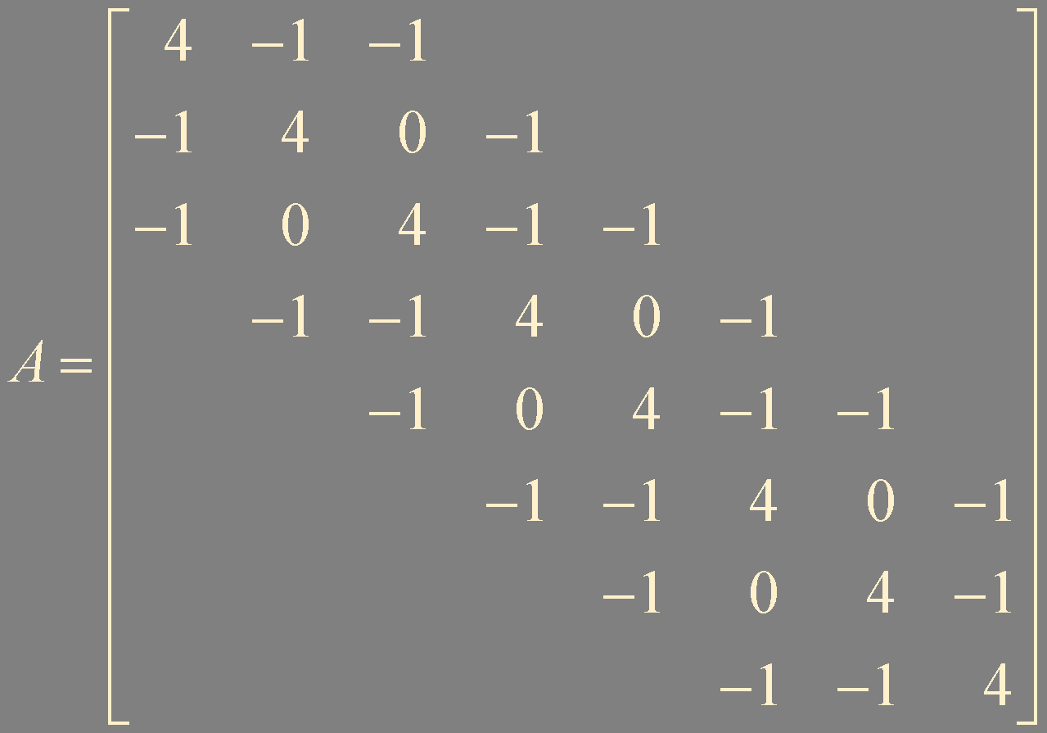

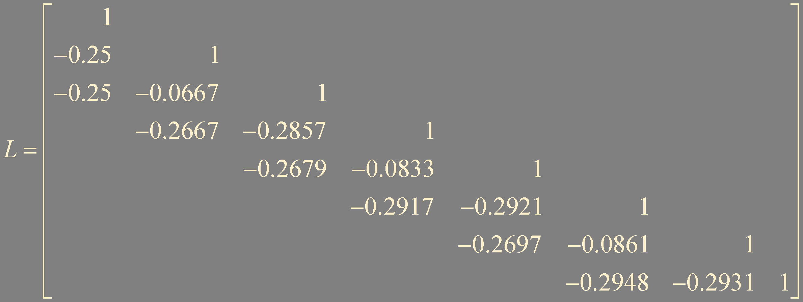
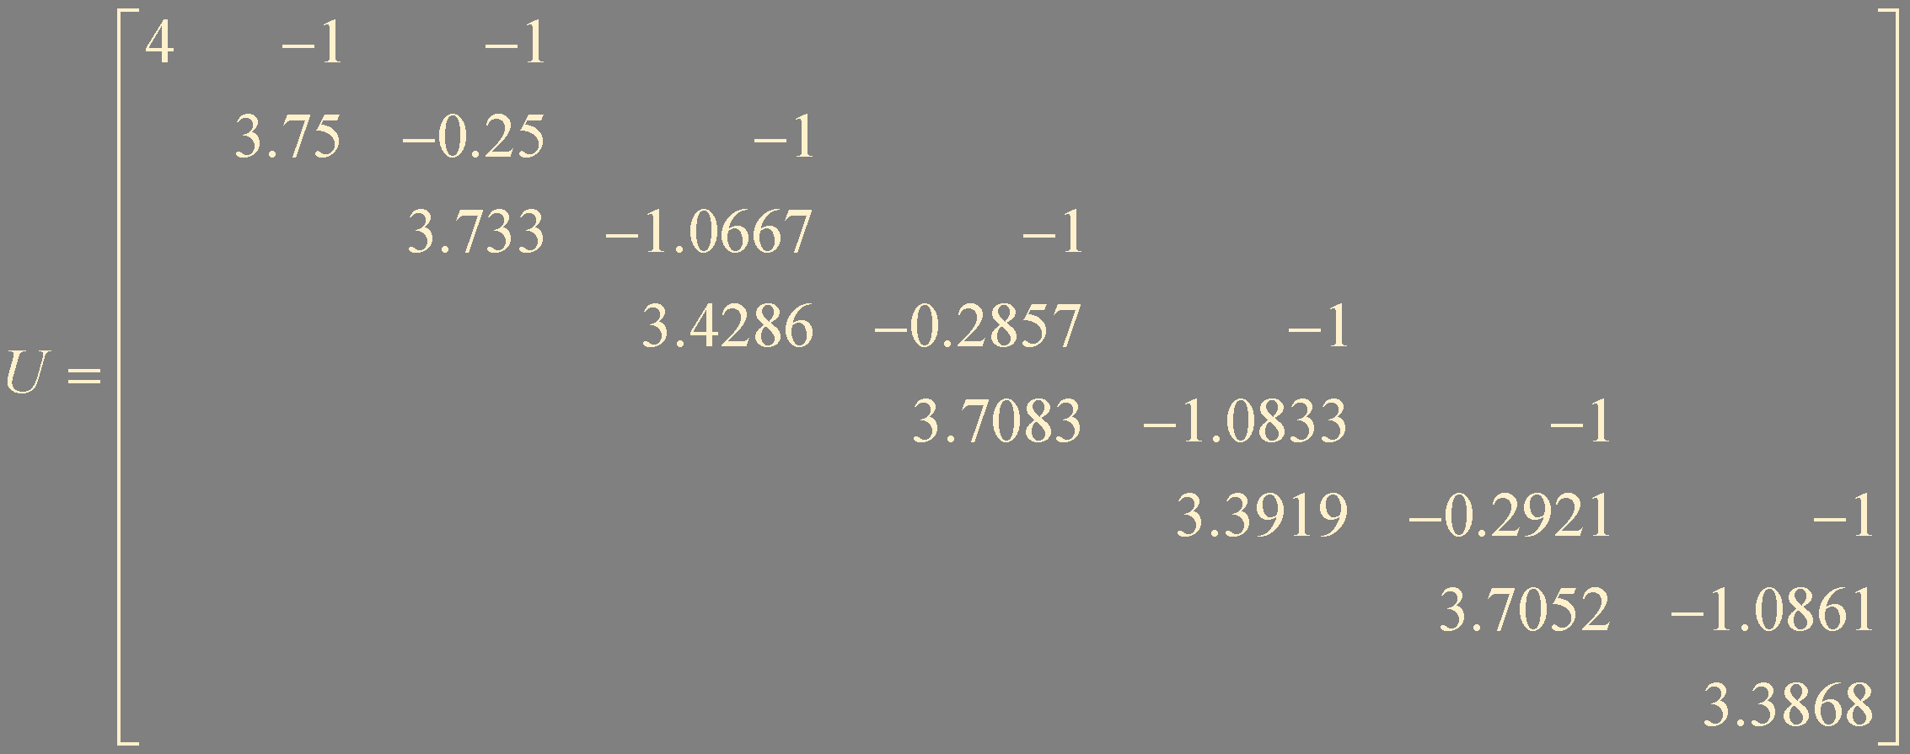
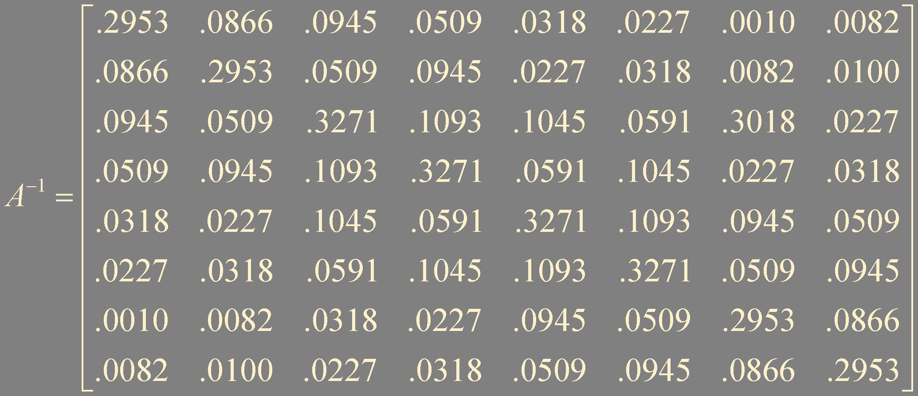
Ax = b

Slide 12
Summary
LU factorization

